Slide 1
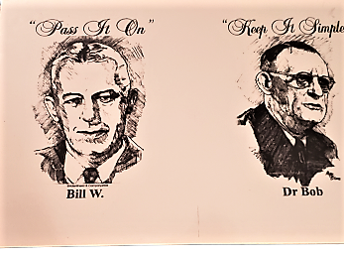


AREA 14 ARCHIVES DISPLAY

Slide 2
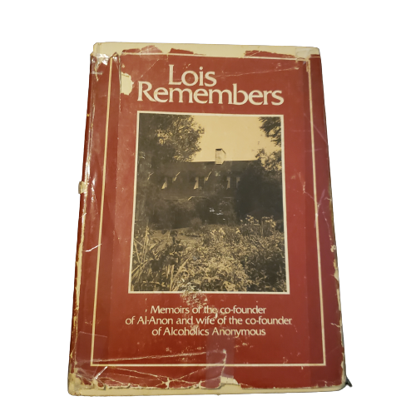
“Lois Remembers”
Published by
Al-Anon Family Group Headquarters, Inc., 1979
This book is about the personal story of the cofounders of AA and Al-Anon from Lois’s perspective.
Lois tells how the Twelve Steps, and the Twelve Traditions grew out of the early AA members and groups experiences, and were adopted later by Al-Anon.

Slide 3
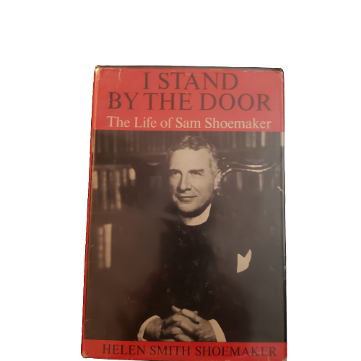
“I Stand by the Door”
The Life of Sam S.
By Helen S.
Sam S. helped A.A. in fundamental ways. Physically, he provided refuge for alcoholics in New York though Calvary Church. Of greater importance was his spiritual aid, which directly influenced the Twelve Steps and the nature of A.A.’s program of recovery. His long and close friendship with Bill W. provided support to the co-founder, and helped the Fellowship weather its fledgling years.

Slide 4
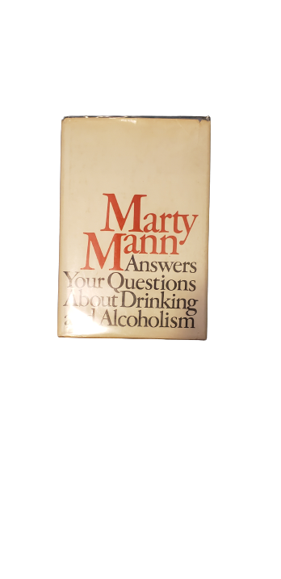
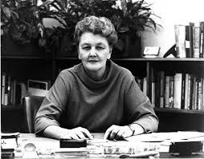

Marty M.
Marty M. was one of the first women pioneers in AA. In addition to having her story featured in the Big Book (page 200 in the 4th edition, “Women Suffer Too.”), in 1950 she authored “Marty M. New Primer on Alcoholism” which is still considered a classic reference today. Marty was on the forefront of the movement that brought an awareness to alcoholism as a “disease” and Alcoholics Anonymous, as its remedy.

Slide 5
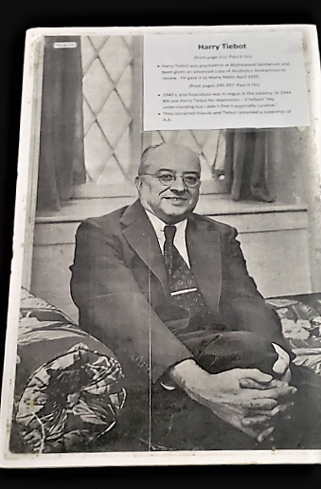
Poster of Harry T.
Harry T.
(from page 211: Pass it On)
Harry T. was a psychiatrist at Blythewood Sanitarium and been given an advance copy of Alcoholics Anonymous for review. He gave it to Marty M. April 1939.
(from pages 295-297: Pass it On)
1940’s psychoanalysis was in vogue in the country. In 1944, Bill W. saw Harry T. for depression… it helped “my understanding but I didn’t find it especially curative”.
They remained friends and Harry T. remained a supporter of A.A.

Slide 6
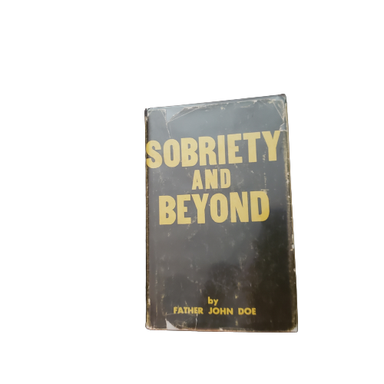
Sobriety and Beyond
By
Father John Doe
An exploration of the spiritual threads of AA, from the perspective of a recovering priest. Father Ralph P., known originally as Father “John Doe” traces the spiritual roots of Alcoholics Anonymous and explains the fundamental and enduring truths contained in the Twelve Steps. This is a wonderful resource for discovering the spiritual contentment, mental peace, and everyday joys to be found in the Twelve Steps. Published in 1955.

Slide 7
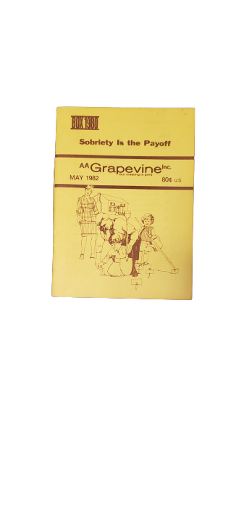
Copy of a Grapevine magazine published May 1982

Slide 8
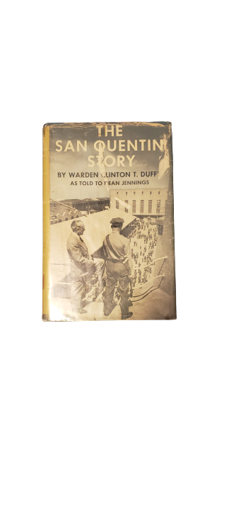
The San Quentin Story
By Warden Clinton T. Duffy
Published January 1, 1950
Clinton T. Duffy was the warden of The San Quentin Prison in San Francisco from 1940-1952. This book is a collection of his stories. He was instrumental in bringing reform into the prison system. San Quentin Prison was the first prison in the country to have a group of Alcoholics Anonymous.

Slide 9
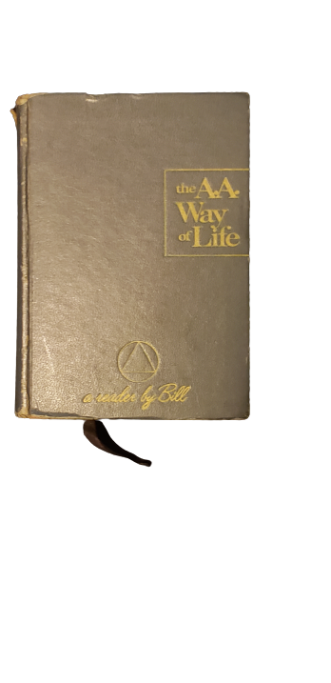
The A.A, Way of Life
By
Bill W.
This is the original text of "As Bill Sees It". The page numbers of "As Bill Sees It" coincide and the text is true to the "AA Way of Life".

Slide 10
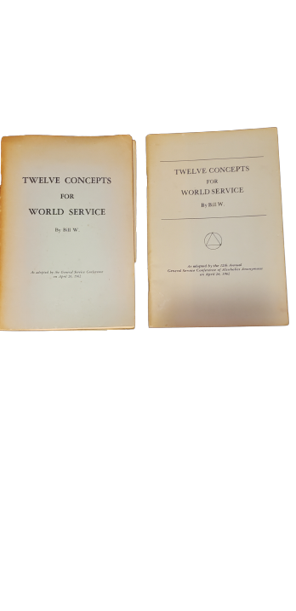
Two copies of the
“Twelve Concepts for World Services”
Published in 1962

Slide 11
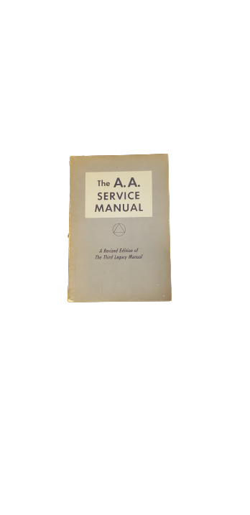
The A.A.
Service Manual
A revised Edition of
The Third Legacy Manual
Published 1969

Slide 12
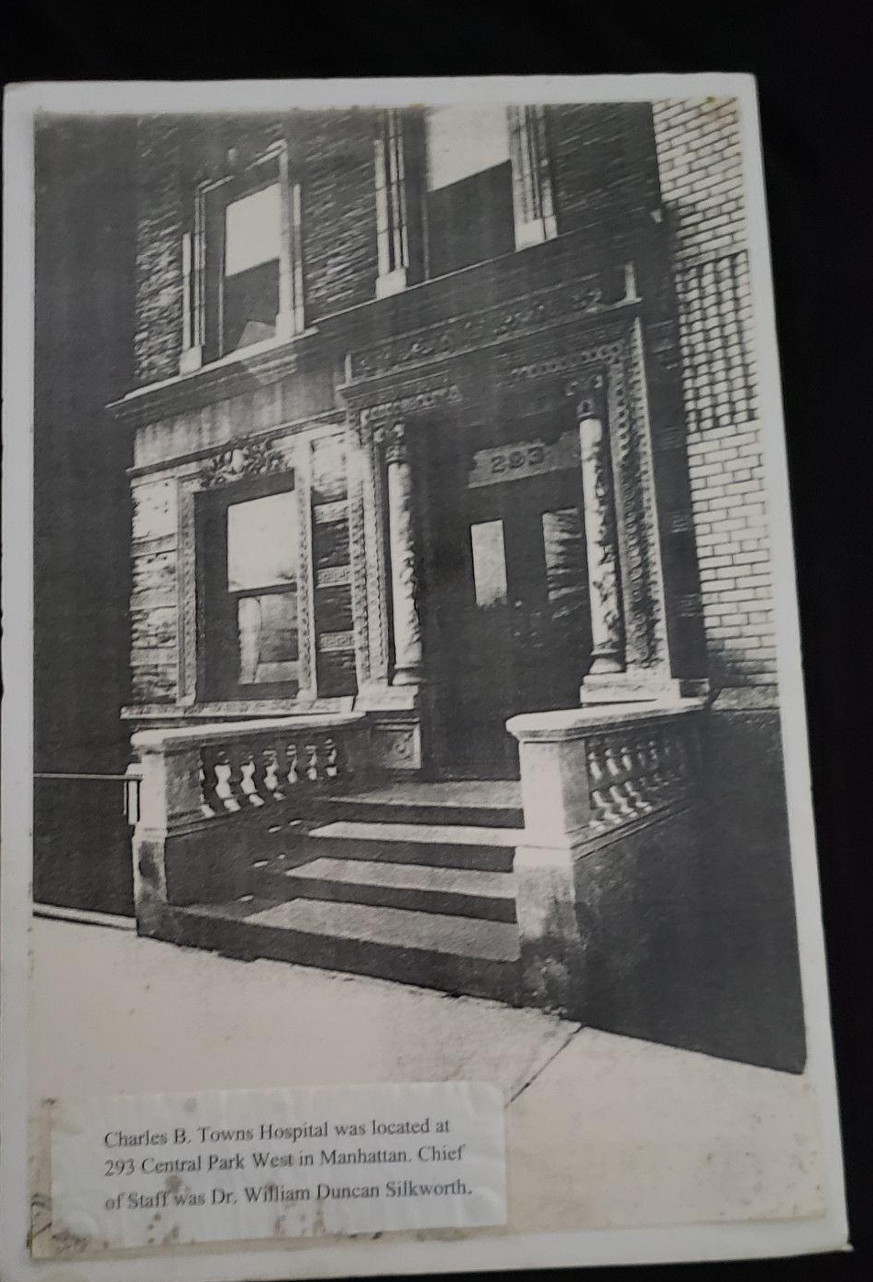
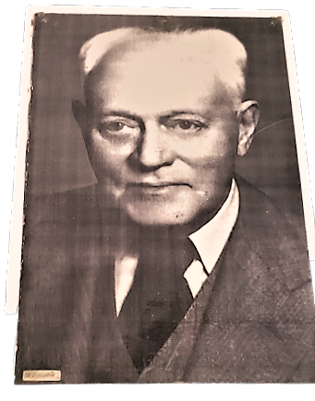
Charles B. Towns Hospital
293 Central Park West in Manhattan
Chief of Staff was Dr. William S.

Slide 13
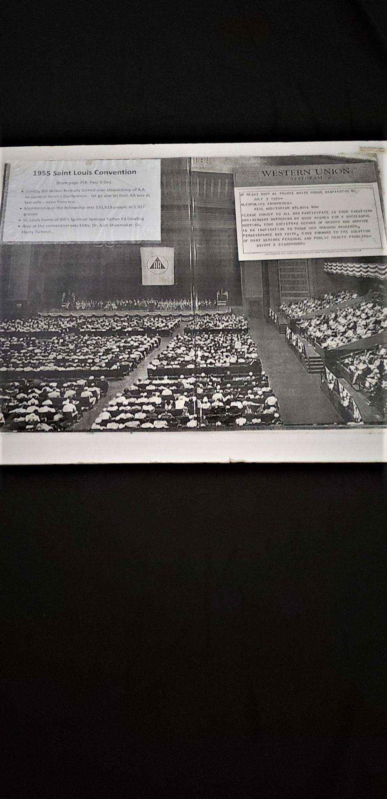
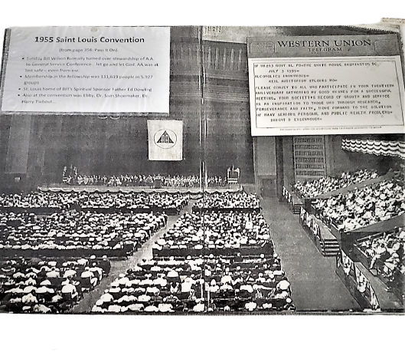
Poster of the 1955 St. Louis Convention and Western Union Telegram from President Eisenhower.
1955 Saint Louis Convention
(from page 358: Pass it On)
Sunday Bill W. formally turned over stewardship of A.A. to General Service Conference... let go and let God. AA was at last safe - even for me.
Membership in the fellowship was 131,619 people in 5,927 groups
St. Louis home of Bill’s Spiritual Sponsor Father Ed D.
Also at the convention was Ebby, Dr. Sam S., Dr. Harry T....

Slide 14
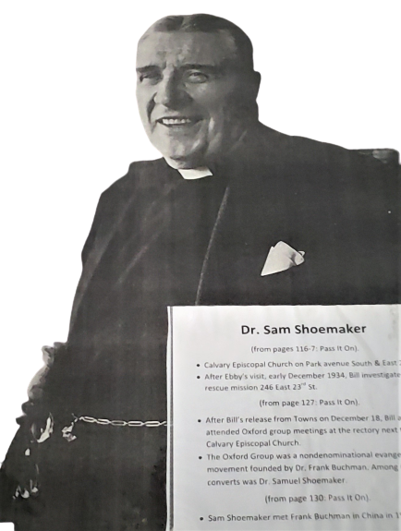
Poster of Dr. Sam S.
Dr. Sam S.
(from pages 116-117: Pass it On)
Calvary Episcopal Church on Park Avenue South East 21st St.
After Ebby’s visit, early December 1934, Bill W. investigated rescue mission 246 East 23rd St.
(from page 127: Pass it ON)
After Bill’s release from Towns on December 18, Bill and Lois attended Oxford Group meetings at the rectory next to Calvary Episcopal Church.
The Oxford Group was a nondenominational evangelical movement founded by Dr. Frank B.. Among its first converts was Dr. Samuel S..
(from page 130: Pass it On)
Sam S. met Frank B. in China in 1918.

Slide 15
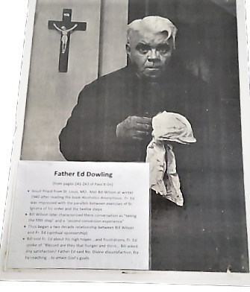
Poster of Father Ed D.
Father Ed D.
(from pages 241 - 243 of Pass it On)
Jesuit Priest from St. Louis MO. Met Bill W. the winter of 1940 after reading the book “Alcoholics Anonymous”. Fr. Ed was impressed with the parallels between exercises of St. Ignatia of his order and the twelve steps.
Bill W. later characterized their conversation as “taking the fifth step” and a “second conversion experience”.
Thus began a two decade relationship between Bill W. and Fr. Ed (spiritual sponsorship).

Slide 16

Alcoholics Anonymous
“Big Book”
1st Edition
Published 10 April 1939

Slide 17
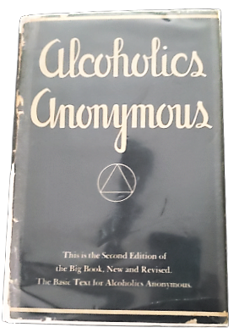
Alcoholics Anonymous “Big Book”
2nd Edition
Published 1 January 1973

Slide 18

Alcoholics Anonymous
“Big Book”
3rd Edition
Published 1 January 1976

Slide 19

Alcoholics Anonymous
“Big Book”
4th Edition
Published 2001

Slide 20
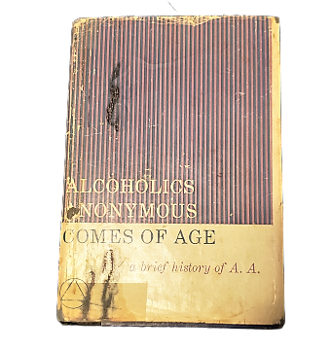
Alcoholics Anonymous Comes of Age:
A Brief History of A. A.
June 1, 1957.

Slide 21
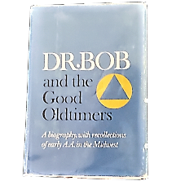
Dr. BOB AND THE GOOD OLDTIMERS :
A Biography, With Recollections of Early A.A. in the Midwest
January 1, 1980.

